Slide 1
How to create an interactable ?
Like buttons or whatever

Slide 2
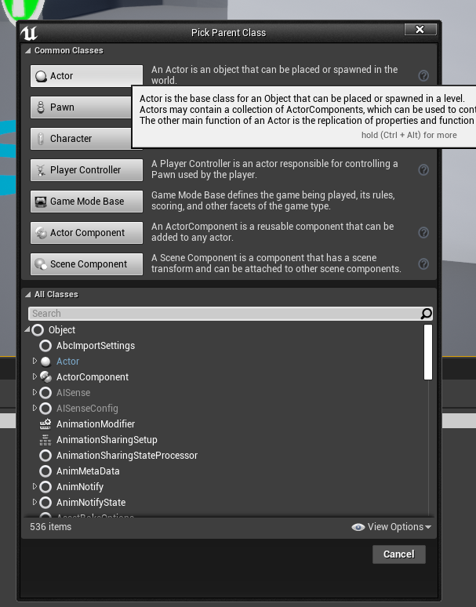
1. Create your blueprint from Actor

Slide 3
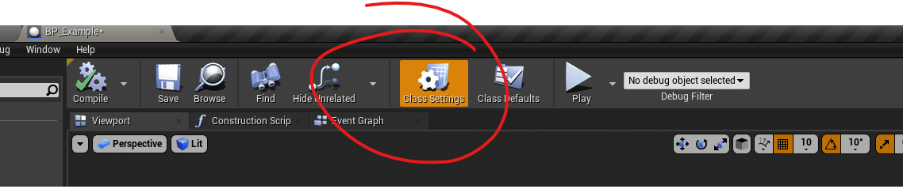
2. Edit Class Settings by pressing this button

Slide 4
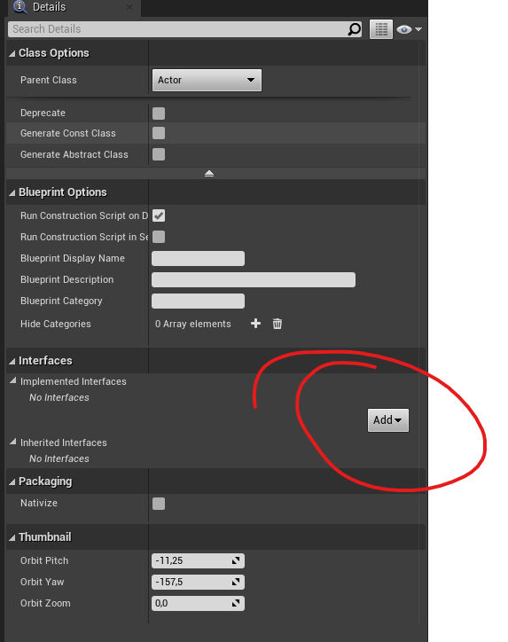
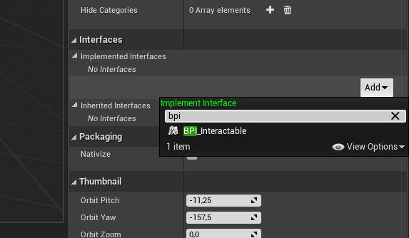
3. Add an new interface

Slide 5
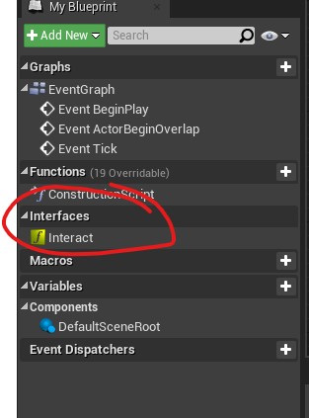
« My Blueprint » tab will look like that now

Slide 6
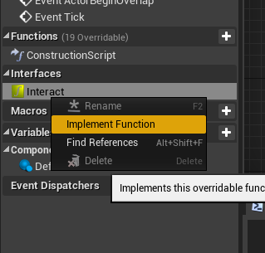
4. Implement the function Interact

Slide 7
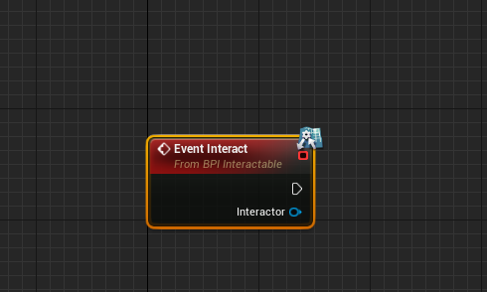
And we’re done =)
This node will be called when the player interact with your BP.
Add what you want there.

